Slide 1
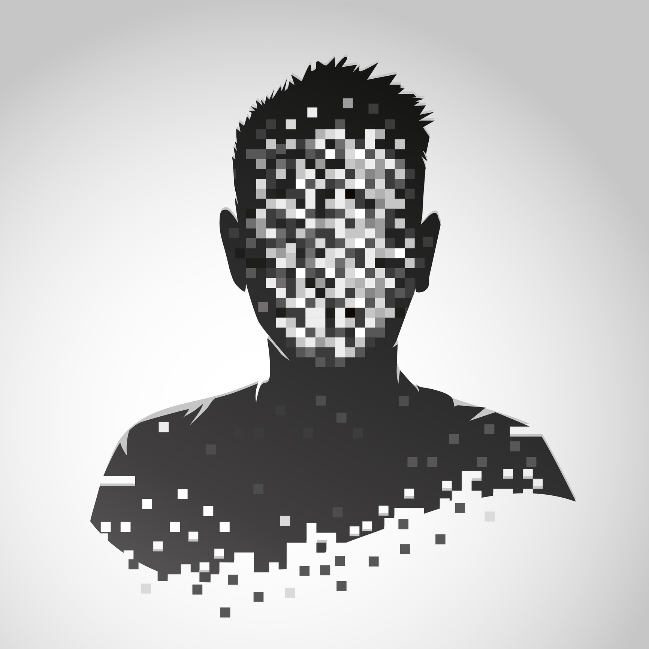
Final Project Evaluation
Image Anonymizer
Team Member:
Gautam Kumar (B19EE031)
Borkar Ankur (B19CSE025)

Slide 2
The Problem Statement
The project aims to address the need for effective image anonymization methods in the digital age, where images can contain sensitive information.
The goal is to develop robust techniques that ensure privacy protection while preserving the usefulness of the images for analysis and understanding, thereby complying with data protection laws.

Slide 3
Image Anonymizer
Image anonymization safeguards privacy in a world of widespread image sharing and analysis.
It involves removing or altering personal details like faces or license plates to protect individuals' identities and prevent unauthorized use of their information.
Compliance with privacy regulations such as GDPR is facilitated through image anonymization, ensuring sensitive data remains secure.
Ethical AI relies on image anonymization to prevent biases, unintended disclosure of sensitive information, and foster the development of fair and unbiased machine learning models.
Anonymizing images is crucial for maintaining privacy, protecting individuals' rights, and building trustworthy systems in the era of advanced image data analysis.

Slide 4
Methodology
Prepare a dataset of images with different classes.
Train a machine learning model on the dataset.
Check the test accuracy of the trained model.
Generate adversarial samples using the Projected Gradient Descent (PGD) attack on the sensitive regions of the images.
Evaluate the anonymizer's effectiveness in removing sensitive information while preserving the overall quality of the images, and fine-tune the model as necessary.

Slide 5
PGD (Projected Gradient Descent)
The PGD (Projected Gradient Descent) attack is a powerful iterative technique used in adversarial machine learning to generate adversarial examples.
In the PGD attack, instead of making a one-time perturbation to the input, multiple iterations are performed to refine the perturbation.
The process involves taking small steps in the direction of the gradient of the loss function with respect to the input, while constraining the perturbation to stay within a predefined range or budget.
At each iteration, the perturbation is projected back onto the allowed range to ensure it remains within the specified boundaries.

Slide 6
Outcomes
Attacks | Squeezenet Accuracy |  | Shufflenet Accuracy
Epsilon | Mask Attack | PGD Attack | Mask Attack | PGD Attack
0.001 | 0.54 | 0.54 | 0.63 | 0.63
0.01 | 0.52 | 0.47 | 0.55 | 0.40
0.03 | 0.48 | 0.35 | 0.44 | 0.18
0.05 | 0.43 | 0.26 | 0.37 | 0.10
0.1 | 0.35 | 0.15 | 0.28 | 0.05

Slide 7
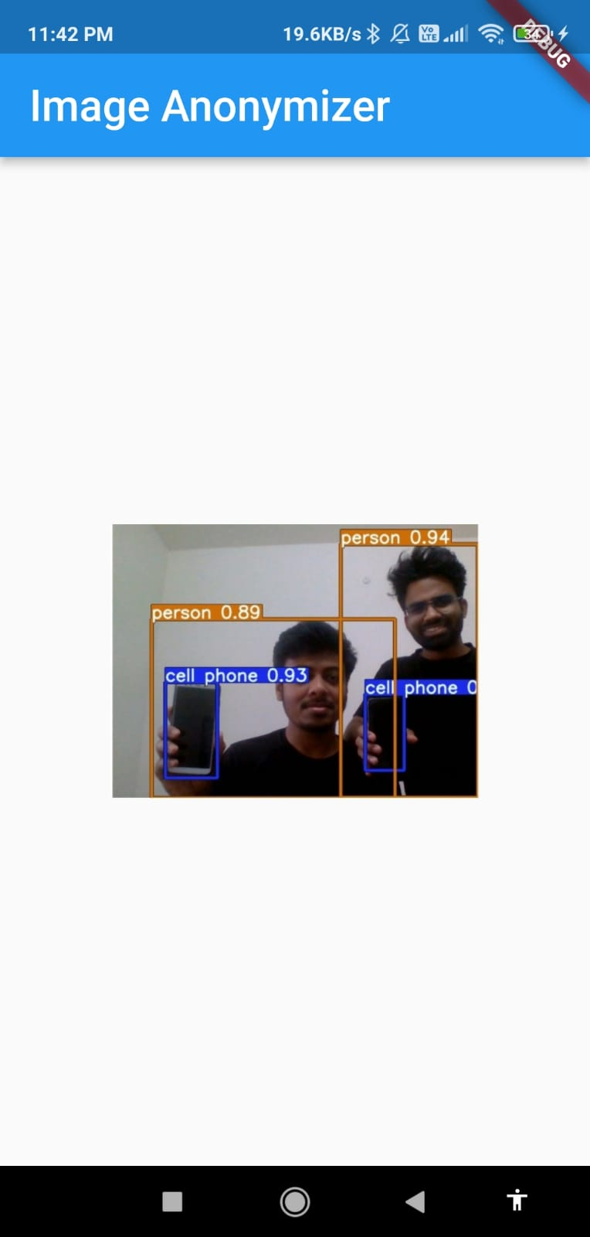
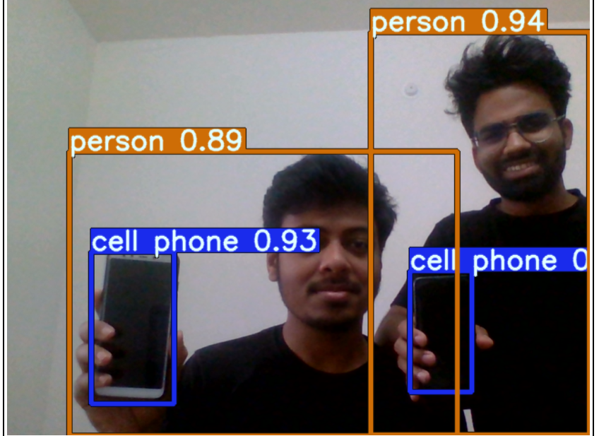
Original Detections
Original Detection

Slide 8
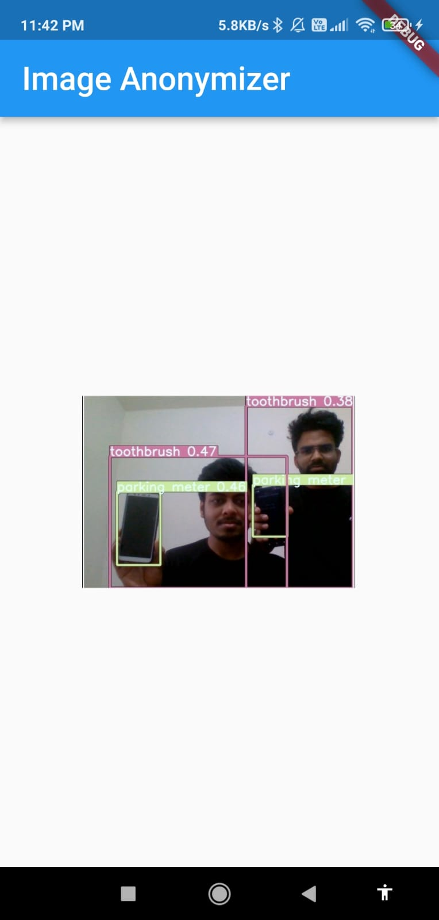
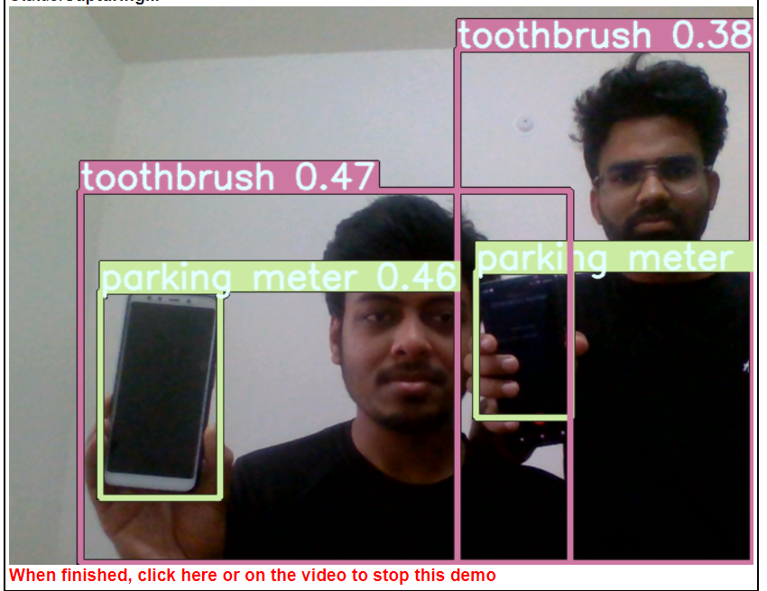
Perturbed Samples

Slide 9
Lessons Learned
Integration of image processing libraries was essential for effective implementation of the anonymization functionality.
Designing a user-friendly interface with clear instructions and proper feedback mechanisms is crucial for a positive user experience.
Rigorous testing and robust error handling mechanisms are vital for ensuring the reliability and stability of the application.
Privacy and security considerations are critical in image anonymization projects.
Continuous improvement of the anonymization model is necessary for enhancing the accuracy and effectiveness of the anonymization process.

Slide 10
Thank you

